Slide 1

ACT-SYS-DT weekly update - 3

Slide 2
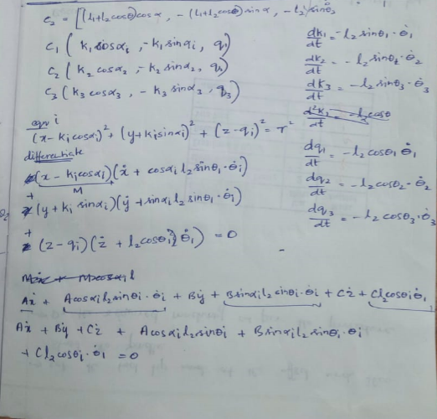
JACOBIAN
MATRIX FOR DELTA ROBOT

Slide 3
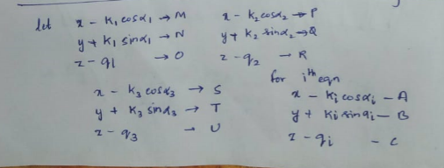

Slide 4
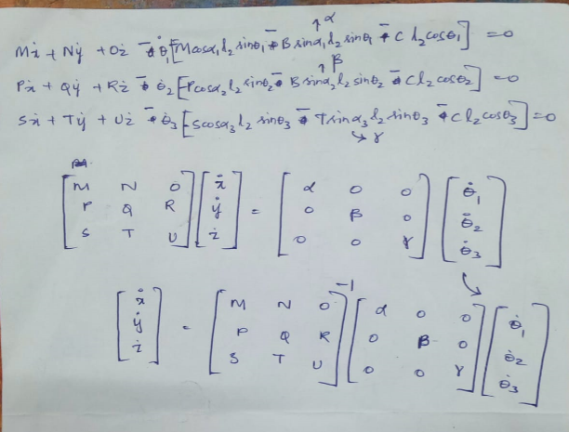

Slide 5

Trajectory Planning
Assume the angle to be a cubic function of time
$θ\left(t\right)=A+Bt+Ct^{2}+Dt^{3}$ ------- Equation 1
Boundary Conditions:
$θ\left(0\right)= θ_{i}$
$θ\left(t_{f}\right)= θ_{f}$
Initial and Final Conditions:
$\frac{d^{2}θ }{{dt}^{2}}(0)=0$
$\frac{d^{2}θ }{{dt}^{2}}(t_{f})=0$

Slide 6
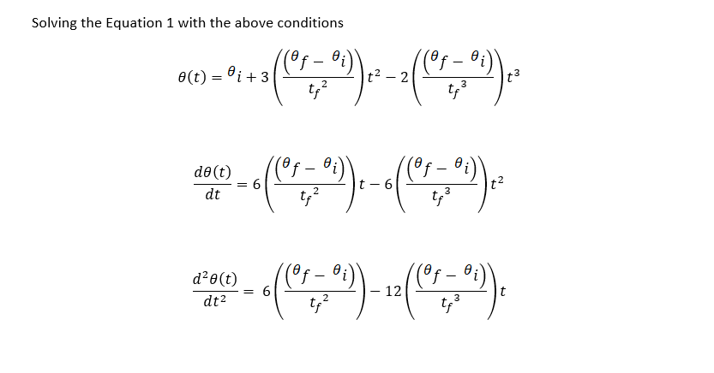
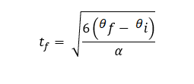
Trajectory Planning

Slide 7
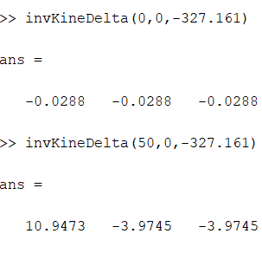
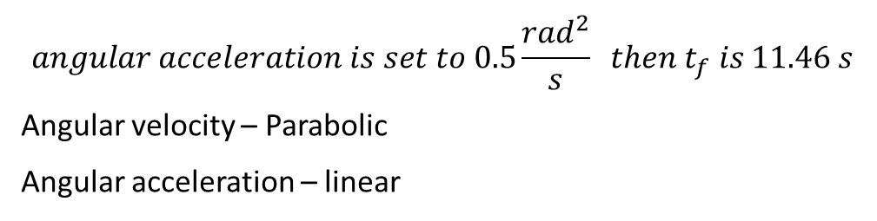
Trajectory Planning
EXAMPLE:
The end effector moves from A (0,0, -327.161) to B (50,0, -327.161)
Calculate the angles using Inverse Kinematics
$$angular acceleration is set to 0.5\frac{{rad}^{2}}{s} then t_{f} is 11.46 s$$
Angular velocity – Parabolic
Angular acceleration – linear

Slide 8
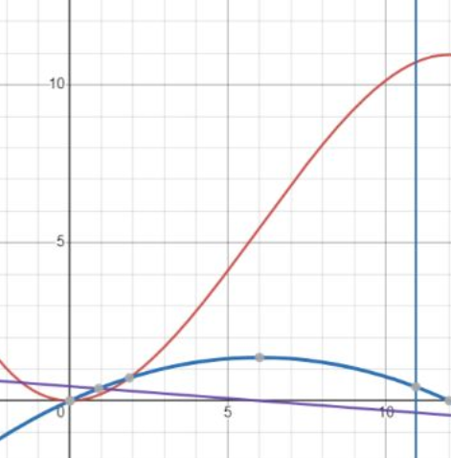
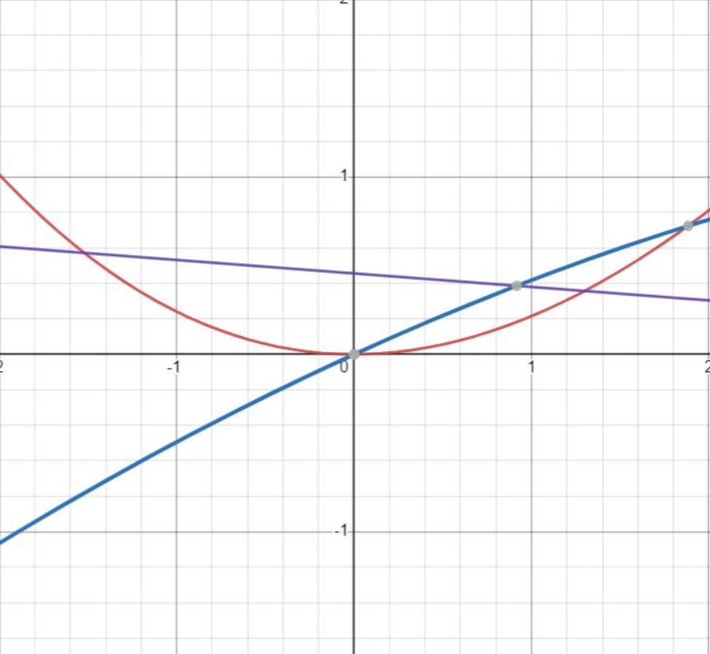
Trajectory Planning

